Slide 1
Topic 7: CIS403 Software Quality Assurance
Software Testing

Slide 2
What is a “Good” Test?
A good test has a high probability of finding an error
A good test is not redundant.
A good test should be “best of breed”
A good test should be neither too simple nor too complex

Slide 3
Topic 3: Test Case Design
"Bugs lurk in corners
and congregate at
boundaries ..."
Boris Beizer
OBJECTIVE
to uncover errors
CRITERIA
in a complete manner
CONSTRAINT
with a minimum of effort and time

Slide 4
Exhaustive Testing not possible!
loop < 20 X
There are 10¹⁴ possible paths! If we execute one test per millisecond, it would take 3,170 years to
test this program!!
Notes:
Exhaustive testing is the process of testing for absolutely everything just to made sure that the product can not be destroyed or crashed so there is a need to look for all possible combos.

Slide 5
Selective Testing
Selected path
loop < 20 X

Slide 6
Classification of Software Testing
Black box (functional) testing
  Testing that ignores the internal mechanism of the system or component and focuses solely on the outputs in response to selected inputs and execution conditions
  Testing conducted to evaluate the compliance of a system or component with specified functional requirements
White box (structural) testing
  Testing that takes into account the internal mechanism of a system or component
  Glass testing or Open box testing

Slide 7
Classification of Software Testing
Grey box testing
Test the application with limited knowledge of the internal workings of an application. In software testing, the term the more you know the better carries a lot of weight when testing an application.
Unlike black box testing, where the tester only tests the application's user interface, in grey box testing, the tester has access to design documents and the database. Having this knowledge, the tester is able to better prepare test data and test scenarios when making the test plan.
Notes:
The purpose of grey box testing is to search and identify the defects due to improper code structure or improper use of applications.

Slide 8
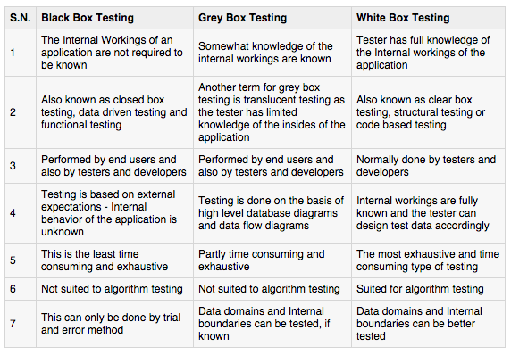
Black box vs. Grey box vs. White box

Slide 9

White-Box Testing
... our goal is to ensure that all
statements and conditions have
been executed at least once ...

Slide 10
Why Cover?
logic errors and incorrect assumptions
are inversely proportional to a path's
execution probability
we often
believe
that a path is not
likely to be executed; in fact, reality is
often counter intuitive
typographical errors are random; it's
likely that untested paths will contain
some

Slide 11
1. Data processing and calculation correctness tests
  Every computational operation in the sequence of operations created by each test case (“path”) must be examined. This helps to decide whether the processing operations and their sequences were programmed correctly for the path in question, but not for other paths.
How to cover all test cases ?
  Path coverage - measured by the percentage of all possible program paths included in planned testing.
  Line coverage – measured by the percentage of program code lines included in planned testing.

Slide 12
1. Data processing and calculation correctness tests
Correctness tests and path coverage
  Different paths are created by the choice in conditional statements, such as IF–THEN–ELSE or DO WHILE or DO UNTIL.
  “Path Coverage” metrics used to measure a path test’s completeness, and defined as the percentage of the program paths executed during the test.
      The number of possible paths created by a simple module containing 10 conditional statements, contains 1024 different paths.
      This situation has encouraged development of an alternative yet weaker coverage concept – line coverage.
Notes:
2 power 10 = 1024

Slide 13
1. Data processing and calculation correctness tests
1. Correctness tests and line coverage
  Line coverage concept requires far fewer test cases but, as expected, leaves most of the possible paths untested.
  For full line coverage, every line of code be executed at least once during the process of testing.
  “Line Coverage” metrics for completeness of a line-testing plan are defined as the percentage of lines indeed executed – that is, covered – during the tests.

Slide 14
Software qualification tests
  Examine the software code (including comments) compliance with coding standards and work instructions.
  Does the code fulfill the code structure instructions and procedures, such as module size, application of reused code, etc.?
  Does the coding style fulfill coding style procedures?
  Do the internal program documentation and “help” sections fulfill coding style procedures?
Maintainability tests
  Refer to special features, such as those installed for detection of causes of failure, module structures that support software adaptations and software improvements, etc.
Reusability tests
  Examine the extent that reused software is incorporated in the package and the adaptations performed in order to make parts of the current software reusable for future software packages.

Slide 15
Adv. and Dis. of white box testing
Advantages:
Direct determination of software correctness as expressed in the processing paths, including algorithms.
Allows performance of line coverage follow up.
Ascertains quality of coding work and its adherence to coding standards.
Disadvantages :
The vast resources utilized, much above those required for black box testing of the same software package.
The inability to test software performance in terms of availability (response time), reliability, load durability, etc.

Slide 16
McCabe’s cyclomatic complexity metrics
The cyclomatic complexity metrics developed by McCabe (1976) measures the complexity of a program or module at the same time as it determines the maximum number of independent paths needed to achieve full line coverage of the program.
The measure is based on graph theory and is thus calculated according to the program characteristics as captured by its program flow graph.

Slide 17
McCabe’s cyclomatic complexity metrics
The cyclomatic complexity metric (V(G)) is expressed in three different ways:
V(G)=R
V(G)=E–N+2
V(G)=P+1
(R) is the areas bounded by edges and nodes. Any enclosed area in the graph is considered a region.
(E) is the number of edges in the program flow graph
(N) the number of nodes in the program flow graph,.
(P) is the number of decisions contained in the graph.

Slide 18
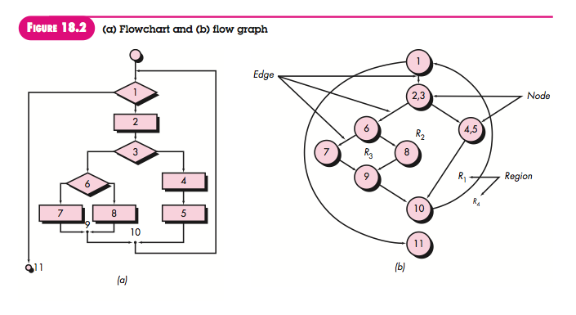
^{V(G)= 4 regions}
^{V(G)= 11edges - 9nodes +} ²⁼ ⁴
^{V(G)=3 predicate nodes + 1 = 4}

Slide 19
McCabe’s cyclomatic complexity metrics
The relationship between the cyclomatic complexity metrics and quality and testability characteristics :
  “Empirical studies reveal that programs with cyclomatic complexities of less than 5 are generally considered simple and easy to understand. Cyclomatic complexities of 10 or less are considered not too difficult; if 20 or more, the complexity is perceived as high.

Slide 20
Basis Path Testing
1
Next, we derive the
independent paths:
2
Since V(G) = 4,
there are four paths
3
Path 1: 1,2,3,6,7,8
4
Path 2: 1,2,3,5,7,8
5
6
Path 3: 1,2,4,7,8
Path 4: 1,2,4,7,2,4,...7,8
Finally, we derive test
7
cases to exercise these
paths.
8

Slide 21
Basis Path Testing Notes
you don't need a flow chart,
but the picture will help when
you trace program paths
count each simple logical test,
compound tests count as 2 or
more
basis path testing should be
applied to critical modules

Slide 22
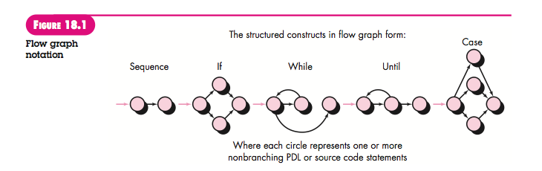
Flow graph notation

Slide 24
Deriving Test Cases
Summarizing:
  Using the design or code as a foundation, draw a corresponding flow graph.
  Determine the cyclomatic complexity of the resultant flow graph.
  Determine a basis set of linearly independent paths.
  Prepare test cases that will force execution of each path in the basis set.

Slide 25
Loop Testing
Simple
loop
Nested
Loops
Concatenated
Loops
Unstructured
Loops

Slide 26
Loop Testing: Simple Loops
Minimum conditions—Simple Loops
1. skip the loop entirely
2. only one pass through the loop
3. two passes through the loop
4. m passes through the loop m < n
5. (n-1), n, and (n+1) passes through
the loop
where n is the maximum number
of allowable passes

Slide 27
Loop Testing: Nested Loops
Nested Loops
Start at the innermost loop. Set all outer loops to their
minimum iteration parameter values.
Test the min+1, typical, max-1 and max for the
innermost loop, while holding the outer loops at their
minimum values.
Move out one loop and set it up as in step 2, holding all
other loops at typical values. Continue this step until
the outermost loop has been tested.
Concatenated Loops
If the loops are independent of one another
then treat each as a simple loop
else* treat as nested loops
endif*
for example, the final loop counter value of loop 1 is
used to initialize loop 2.

Slide 28
Example: The Imperial Taxi Services (ITS) taximeter
ITS taxi fares for one-time passengers are calculated as follows:
Minimal fare: $2. This fare covers the distance traveled up to 1000 yards and waiting time (stopping for traffic lights or traffic jams, etc.) of up to 3 minutes.
For very additional 250 yards or part of it: 25 cents.
For every additional 2 minutes of stopping or waiting or part thereof: 20 cents.
One suitcase: 0 change; each additional suitcase: $1.
Night supplement: 25%, effective for journeys between 21.00 and 06.00.
Regular clients are entitled to a 10% discount and are not charged the night supplement.

Slide 29
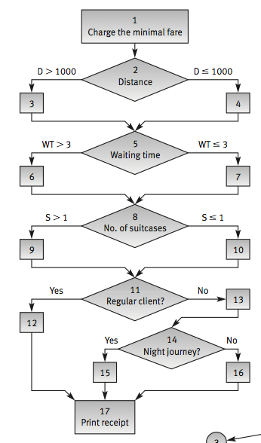
ITS - Flow chart

Slide 30
Full line coverage of the ITS software module can be reached by inspecting the minimum number of paths.
1
2
R1
4
3
5
ITS – Program flow graph
7
6
R2
8
R6
9
R3
10
11
12
13
R4
15
14
R5
16
17

Slide 31
1
2
R1
4
3
ITS – Program flow graph
5
6
R2
7
8
R6
9
R3
10
11
12
13
R4
15
14
R5
16
17

Slide 32
ITS - The maximum
set of independent paths
V(G)=R=6
V(G)=E-N+2=21-17+2=6
V(G)=P+1=5+1=6
1
R=Regions
N=Nodes
E=Edges
P=Decisions
2
R1
4
3
5
6
R2
7
8
R6
9
R3
10
11
12
13
R4
15
14
McCabe’s cyclomatic complexity metrics
R5
16
17

Slide 33
Full path coverage = 24 paths = 24 test cases
Full line coverage = 3 paths = 3 test cases
1:8
Notes:
Full path coverage is when every possible route through your code is executed during the testing

Slide 34
Black box testing
Black box testing focuses on functional RE and enables to derive sets of input conditions that fully exercise all functional RE for a program.
Unlike white box testing, which is performed early in the testing process, black box testing tends to be applied during later stages of testing.

Slide 35
Adv. and dis. of black box testing
Advantages:
Allows us to carry out the majority of testing classes, most of which can be implemented solely by black box tests, i.e. load tests and availability tests.
For testing classes that can be carried out by both white and black box tests, black box testing requires fewer resources.
Disadvantages:
Possibility that coincidental aggregation of several errors will produce the correct response for a test case, and prevent error detection.
Absence of control of line coverage. There is no easy way to specify the parameters of the test cases required to improve coverage.
Impossibility of testing the quality of coding and its strict adherence to the coding standards.

Slide 36
  Output correctness test
“Data processing and calculation test” is part of output correctness test.
The output correctness tests apply the concept of test cases.
Improved choice of test cases can be achieved by the efficient use of equivalence class partitioning method:
        divide the input domain of a program into “equivalence” classes of data from which test cases can be derived.

Slide 37
Documentation tests
Common components of documentation, supplied by the developer, are:
  Functional descriptions of the software system.
  Installation manual.
  User manual.
  Programmer manual.
Document testing plans should include the following three components:
  Document completeness check. Based on the requirements specification and the detailed design reports, its purpose is to check whether all the required documents have been completed as specified and as intended by the designer.
  Document correctness tests. Correctness tests determine whether the instructions listed in the user document are correct.
  Document style and editing inspection. Refers to document clarity and its agreement with documentation standards in cases this requirement is specified in the contract.
Notes:
Documentation testing, though neglected in many cases, should be consid- ered as important as code testing or design documents inspections. An erroneous user manual or programmer manual can lead to mistakes during program operation and maintenance that may incur damages equivalent in severity to those caused by software bugs.

Slide 38
Availability tests
It is defined as reaction time: the time needed to obtain the requested information or the time required for firmware installed in computerized equipment to react.
Availability is of highest importance in online applications of frequently used information systems. The failure of firmware software to meet availability can make the equipment useless.
Difficult to test, especially for systems that serve a large population of users.

Slide 39
Reliability tests
The software system reliability requirement deals with features that can be translated as events occurring over time, such as:
  average time between failures (e.g., 500 hours)
  average time for recovery after system failure (e.g., 15 min)
  average downtime per month (e.g., 30 minutes per month)

Slide 40
Stress tests
The class of stress tests subsumes two main types of tests:
  load tests : conducted for loads higher than those indicated in the requirements specification.
  durability tests: carried out in physically extreme operating conditions such as high temperatures, humidity, and high-speed driving along unpaved rural roads.
It is possible to perform these tests only subsequent to software system completion.

Slide 41
Software security system tests
Aimed at preventing unauthorized access to the system or parts of it, detection of unauthorized access and the activities performed by the penetration, and the recovery of damages caused by unauthorized penetration cases.
The main security issues dealt with by these tests are:
  Access control
  Backup of databases and software files and recovery in cases of system failure.
  Logging of transactions, system usage, access trials, and so forth.

Slide 42
Equivalence class partitioning method
Method guidelines
If an input condition specifies a range, one valid and two invalid equivalence classes are defined.
If an input condition requires a specific value, one valid and two invalid equivalence classes are defined.
If an input condition specifies a member of a set, one valid and one invalid equivalence class are defined.
If an input condition is Boolean, one valid and one invalid class are defined.

Slide 43
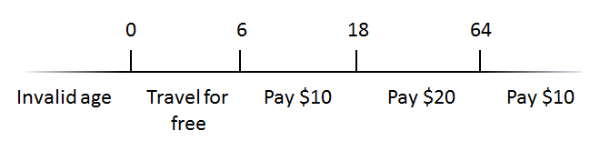
  Equivalence class partitioning method
Example:
  In the ticketing system, children under age 6 are allowed to travel for free, people under 18 as well as senior people 64 and older pay $10 while adults need to pay $20.
  For testing this system, we can use equivalence class partitioning to design our tests.

Slide 44
Equivalence class partitioning method
When the equivalence classes involve numbers, there are decision boundaries between them. These are places where the behavior of the system changes.
What makes boundary value analysis an interesting method ?
It is widely recognized that values on the boundaries cause more errors in system. Therefore we should be always checking the boundaries as if the system fails, it is likely to fail on these decision boundaries.
Finding boundary values for numbers:
If input condition specifies a range bounded by certain values, say, a and b, then test cases should include:
Values for a and b
Values just above and just below a and b

Slide 45
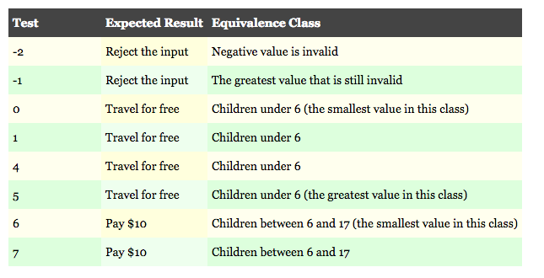
The following table shows the input values used to test the boundary around 0 and 6:

Slide 46
Equivalence Partitioning
user
queries
output
formats
data
mouse
picks
prompts

Slide 47
Sample Equivalence Classes
Valid data
user supplied commands
responses to system prompts
file names
computational data
physical parameters
bounding values
initiation values
output data formatting
responses to error messages
graphical data (e.g., mouse picks)
Invalid data
data outside bounds of the program
physically impossible data
proper value supplied in wrong place

Slide 48
Boundary Value Analysis
user
queries
output
formats
FK
input
mouse
picks
data
prompts
output
domain
input domain

Slide 49
Resources
Software Engineering, Pearson by Ashok Mohanty, Jibitesh Mishra.

